Slide 1
Smart Safety and Tracking System for Dementia Patients using IoT
Team– 1.Shreya Singh – 23BEE1053
2.Tanuj Rai – 23BEE1086

Slide 2
Problem Statement
Real-time monitoring of elderly patients remains a significant challenge, especially in non-clinical environments. Continuous supervision by caregivers is impractical due to time, cost, and manpower constraints. Accidental falls may go undetected, leading to delayed medical assistance and increased health risks. Affordable solutions supporting both indoor and outdoor geofencing are limited. Existing systems offer minimal support for tracking multiple users simultaneously. Most available solutions are costly, complex, and difficult to deploy for everyday use.

Slide 3
Proposed Solution
A smart, multi-user safety and tracking system designed for elderly and patient monitoring.
RFID-based user identification to uniquely recognize each individual.
GPS module for real-time location tracking.
MPU6050 sensor for continuous motion monitoring and fall detection.
Geofencing implemented using the Haversine formula for indoor and outdoor safety zones.
Buzzer alerts triggered during falls or when a user exits the defined geofence.
Wi‑Fi enabled live monitoring dashboard for caregivers.
Secure storage of the last known location for each user to ensure traceability.

Slide 4
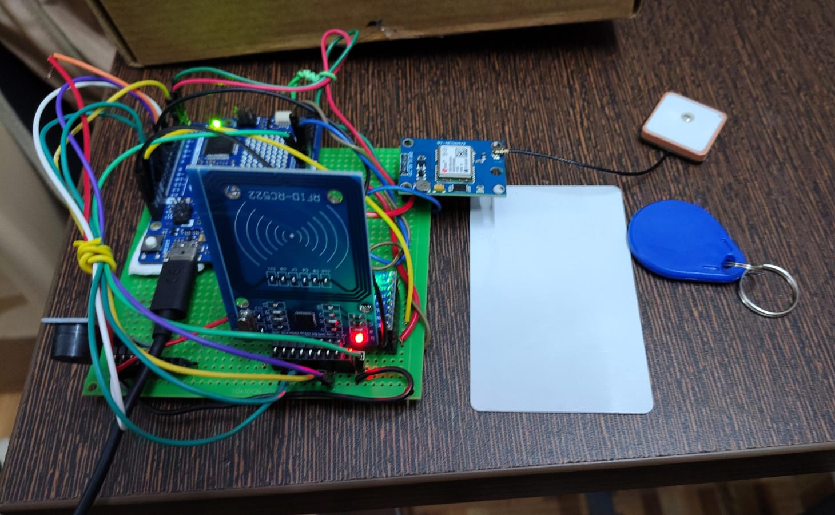
Working Principle
A low-cost, reliable, and efficient smart safety monitoring system was successfully designed and implemented.
The system enables real-time location tracking, fall detection, and geofencing for elderly and patient safety.
Wireless connectivity allows caregivers to remotely monitor users without continuous physical supervision.
The solution is scalable for multi-user tracking and suitable for both indoor and outdoor environments.
This system provides an effective and practical approach to improving patient safety using IoT technology.
Fig 1- Complete setup of the prototype

Slide 5
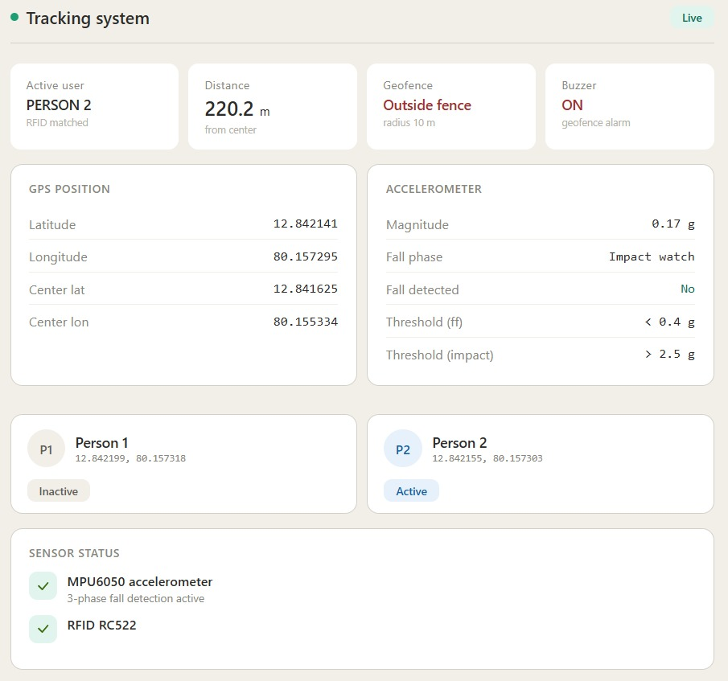
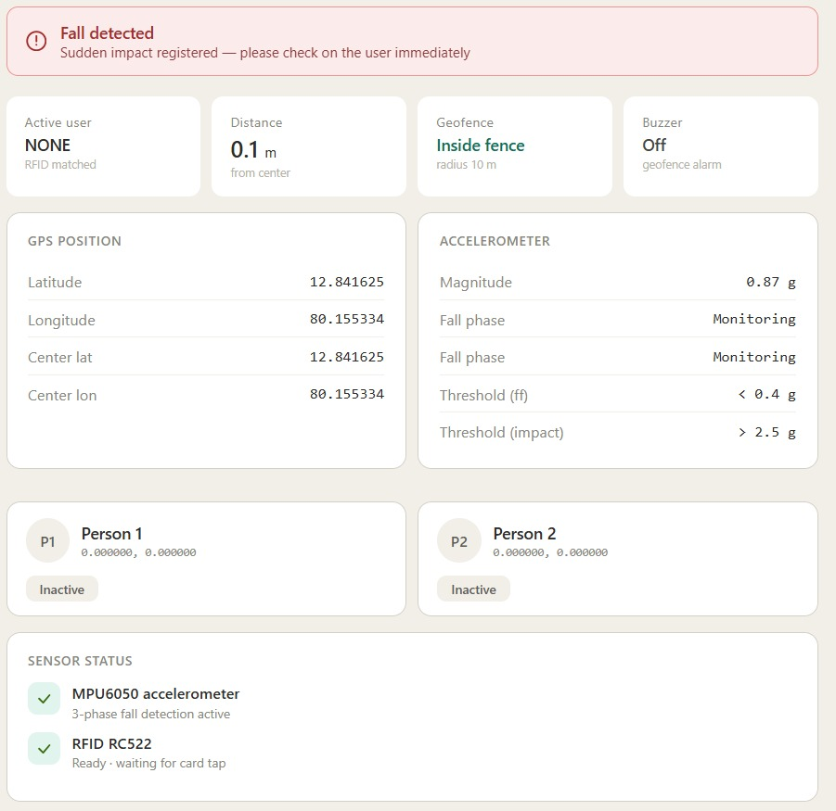
Results and Conclusion
A low-cost, reliable, and efficient smart safety monitoring system was successfully designed and implemented.
The system enables real-time location tracking, fall detection, and geofencing for elderly and patient safety.
Wireless connectivity allows caregivers to remotely monitor users without continuous physical supervision.
The solution is scalable for multi-user tracking and suitable for both indoor and outdoor environments.
This system provides an effective and practical approach to improving patient safety using IoT technology.
Fig 2: Geofencing Result
Fig 3: Fall Detection Result

